Slide 1
COMP 3400
Week 7 - Friday

Slide 2
Last time
What did we talk about last time?
Finished TCP programming: HTTP
Started UDP programming: DNS

Slide 3
Questions?

Slide 4
Project 2

Slide 5
Reminders about sizeof

Slide 6
sizeof
In C, the sizeof operator was designed to get the size of types and variables in bytes
It should be used to get information known at compile time
It can never know the length of:
Files
Strings
Dynamically allocated memory
Yes, it's called sizeof, but a lot of things have non-intuitive names in CS

Slide 7
Testing your sizeof knowledge
int array[100];
char word1[] = "goats";
char word2[50] = "goats";
char* word3 = "goats";
int x = 500;
char* data = malloc(100);
int fd = open("file.txt", O_RDONLY);
Given the above code, what is the value of each?
sizeof(array)
sizeof(array) – 1
sizeof(array - 1)
sizeof(word1)
sizeof(word2)
sizeof(word3)
sizeof("goats")
sizeof(x)
sizeof(data)
sizeof(fd)
Answers given on next slide

Slide 8
Answers
int array[100];
char word1[] = "goats";
char word2[50] = "goats";
char* word3 = "goats";
int x = 500;
char* data = malloc(100);
int fd = open("file.txt", O_RDONLY);
Note that these answers are based on the Ubuntu in the lab, which uses 64-bit addresses
sizeof(array) 400
sizeof(array) – 1 399
sizeof(array - 1) 8
sizeof(word1) 6
sizeof(word2) 50
sizeof(word3) 8
sizeof("goats") 6
sizeof(x) 4
sizeof(data) 8
sizeof(fd) 4

Slide 9
Back to DNS

Slide 10
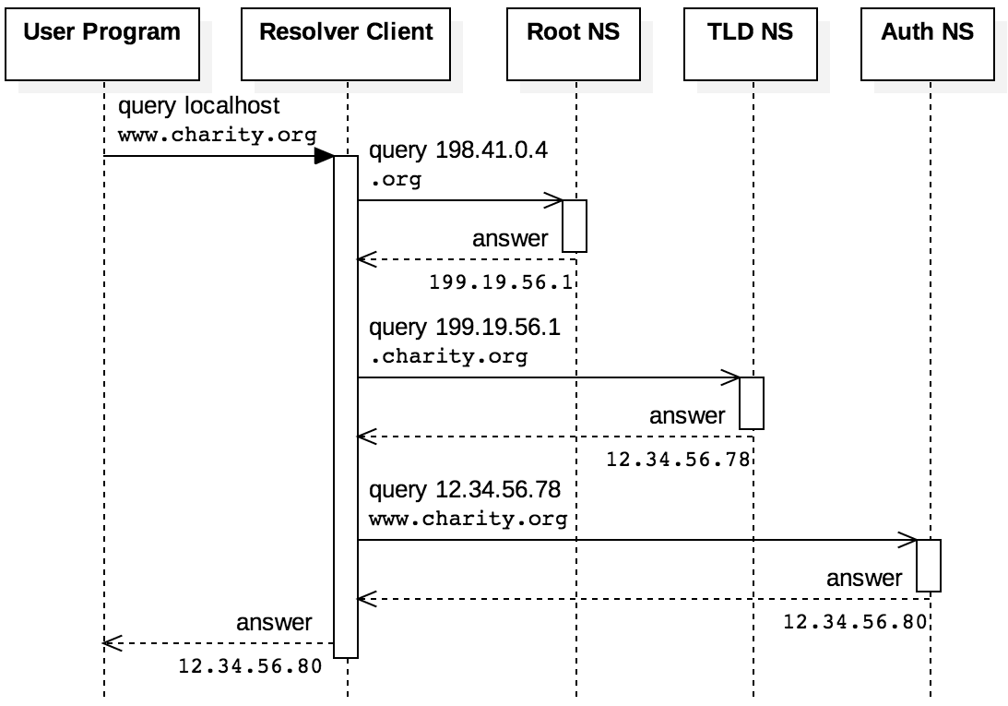
DNS queries
Queries can be iterative:
Ask the root, get a response for the TLD
Ask the TLD for the domain you want
Get a response closer to what you're looking for and repeat
Shown on the right
Queries can also be recursive:
Ask a name server, it handles everything
To make the system efficient, servers cache domains that have been asked for recently
There's a time-to-live value that says how long a cached domain should be kept

Slide 11
DNS resource record structure
DNS information is sent in resource records, which have the following form:
NAME is the human-readable domain name
TYPE is gives the kind of record
A is an IP address
CNAME is a canonical name
NS is an authoritative name server
CLASS is what protocol, often IN for Internet
TTL is time-to-live in a cache
RDLENGTH is the length of the data in the record
RDATA is the data
NAME and RDATA are variable length, and all other fields are 16 bits
NAME
TYPE
CLASS
TTL
RDLENGTH
RDATA

Slide 12
DNS requests
Like HTTP, DNS is a request-response protocol
Unlike HTTP, DNS uses UDP and messages aren't as human readable
DNS messages contain five fields: header, question, answer, authority, and additional
Headers start with a random ID to keep messages straight
Example request to resolve example.com:
Field | Data in Hex | Meaning
Header | 1234 | XID=0x1234
 | 0100 | OPCODE=SQUERY
 | 0001 0000 0000 0000 | 1 question field
Question | 0765 7861 6d70 6c65 0363 6f6d 00 | QNAME=EXAMPLE.COM
 | 0001 0001 | QCLASS=IN, QTYPE=A
Answer
Authority
Additional
Note:
Instead of dots, QNAME gives the number of characters for each name part
Character | 7 | e | x | a | m | p | l | e | 3 | c | o | m | 0
Hex | 07 | 65 | 78 | 61 | 6d | 70 | 6c | 65 | 03 | 63 | 6f | 6d | 00

Slide 13
DNS responses
Here's a reasonable response to the request from the previous slide
Don't worry about the OPCODE, it's a set of bits laid out according to DNS rules
QNAME uses a special code to indicate that the name is 12 bytes into this response (to avoid repetition)
Field | Data in Hex | Meaning
Header | 1234 | XID=0x1234
 | 8180 | OPCODE=SQUERY, RESPONSE, RA
 | 0001 0001 0000 0000 | 1 question and 1 answer
Question | 0765 7861 6d70 6c65 0363 6f6d 00 | QNAME=EXAMPLE.COM
 | 0001 0001 | QCLASS=IN, QTYPE=A
Answer | c00c | QNAME=EXAMPLE.COM [compressed]
 | 0001 | QTYPE=A
 | 0001 | QCLASS=IN
 | 0000 e949 | TTL = 0xe949 = 59721
 | 04 | RDLENGTH = 4
 | 0x5db8d822 [93.184.216.34] | RDATA
Authority
Additional

Slide 14
Brief interlude
Did you ever wonder how long a domain name can be?
Each part of the name has a maximum of 63 characters
The whole thing can't be more than 253 characters
Examples:
The Welsh village Llanfairpwllgwyngyllgogerychwyrndrobwllllantysiliogogogoch registered llanfairpwllgwyngyllgogerychwyrndrobwllllantysiliogogogochuchaf.org.uk in honor of the uchaf or upper part of their village
German mathematician Gerard Steffens registered 3.141592653589793238462643383279502884197169399375105820974944592.eu in honor of pi
In 2000 (when both the web and Verizon were fresh and new), Verizon registered verizonsucks.com to keep anyone else from using it
The hacker magazine 2600 registered verizonreallysucks.com
Verizon sued the magazine's publisher
In retaliation, the magazine registered the domain VerizonShouldSpendMoreTimeFixingItsNetworkAndLessMoneyOnLawyers.com

Slide 15
Putting it into code
DNS isn't part of the POSIX standard, so we need our own structs to hold the data
typedef struct {
uint16_t xid; // Randomly chosen identifier
uint16_t flags; // Bit-mask to indicate request/response
uint16_t qdcount; // Number of questions
uint16_t ancount; // Number of answers
uint16_t nscount; // Number of authority records
uint16_t arcount; // Number of additional records
} dns_header_t;
typedef struct {
char *name; // Pointer to the domain name in memory
uint16_t dnstype; // The QTYPE (1 = A)
uint16_t dnsclass; // The QCLASS (1 = IN)
} dns_question_t;

Slide 16
Preparing to send
The following code:
Creates a UDP socket
Makes an IPv4 address with the OpenDNS server 208.67.222.222, which is 0xd043dede in hex on the DNS port of 53
Initializes a dns_header_t with appropriate values
int socketfd = socket (AF_INET, SOCK_DGRAM, 0);
struct sockaddr_in address;
address.sin_family = AF_INET; // IPv4
address.sin_addr.s_addr = htonl (0xd043dede); // 208.67.222.222 (0xd043dede)
address.sin_port = htons (53); // Port 53
// DNS header
dns_header_t header;
memset (&header, 0, sizeof (dns_header_t));
header.xid= htons (0x1234); // Randomly chosen ID
header.flags = htons (0x0100); // Q=0, RD=1
header.qdcount = htons (1); // Sending 1 question

Slide 17
Horrible code to fill in the name
The following code (pretty slickly) fills in the weird naming scheme that requires a count for the length of each name part before it
dns_question_t question;
question.dnstype = htons (1); // QTYPE 1=A
question.dnsclass = htons (1); // QCLASS 1=IN
question.name = calloc (strlen (hostname) + 2, sizeof (char)); // 2 more: \0 and first count
memcpy (question.name + 1, hostname, strlen (hostname));
uint8_t *prev = (uint8_t *) question.name;
uint8_t count = 0; // Count the bytes in a field
for (size_t i = 0; i < strlen (hostname); ++i) // Look for . locations
{
if (hostname[i] == '.') // End of a name part
{
*prev = count; // Store the count into the location before the part
prev = question.name + i + 1; // Update the prev pointer to the new location
count = 0;
}
else
++count;
}
*prev = count; // Store count for last part

Slide 18
Finally sending
Before sending, everything must be packaged into one chunk of memory
// Final packet size
size_t packetlen = sizeof (header) + strlen (hostname) + 2 +
sizeof (question.dnstype) + sizeof (question.dnsclass);
uint8_t *packet = calloc (packetlen, sizeof (uint8_t));
uint8_t *p = (uint8_t *)packet;
memcpy (p, &header, sizeof (header)); // Copy in the header
p += sizeof (header);
// Copy the question name, QTYPE, and QCLASS fields
memcpy (p, question.name, strlen (hostname) + 2);
p += strlen (hostname) + 2;
memcpy (p, &question.dnstype, sizeof (question.dnstype));
p += sizeof (question.dnstype);
memcpy (p, &question.dnsclass, sizeof (question.dnsclass));
// Finally, send the packet over UDP
sendto (socketfd, packet, packetlen, 0, (struct sockaddr *) &addr,
(socklen_t) sizeof (addr));

Slide 19
Getting an answer back
The DNS standard says that a message will never be more than 512 bytes
Thus, we can just read into a fixed-size buffer
socklen_t length = 0;
uint8_t response[512];
memset (&response, 0, 512);
// Receive the response
ssize_t bytes = recvfrom (socketfd, response, 512, 0, (struct sockaddr *) &addr, &length);

Slide 20
Interpreting that answer
The following struct gives us a way to interpret the elements of the answer
Note the __attribute__((packed)) at the bottom
This compiler flag keeps the compiler from reorganizing the fields
It's necessary so that everything matches the output we expect from the DNS server
Compilers will often change struct fields around for greater efficiency
typedef struct {
uint16_t compression;
uint16_t type;
uint16_t class;
uint32_t ttl;
uint16_t length;
struct in_addr addr;
} __attribute__((packed)) dns_record_a_t;

Slide 21
Reconstructing the name
The following code reconstructs the name, putting dots back in it, and lets us see where the data after it is
dns_header_t *response_header = (dns_header_t *)response;
assert ((ntohs (response_header->flags) & 0xf) == 0); // Check for error
// Get a pointer to the start of the question name
uint8_t *start_of_name = (uint8_t *) (response + sizeof (dns_header_t));
uint8_t total = 0;
uint8_t *field_length = start_of_name;
while (*field_length != 0)
{
// Put a dot back in the name and advance to next length
total += *field_length + 1;
*field_length = '.';
field_length = start_of_name + total;
}

Slide 22
Actual DNS information
Finally, after the name, we can skip a null byte, qtype, qclass to get to the answers
Note that we have to be careful to change the data from network to host endianness
dns_record_a_t *records = (dns_record_a_t *) (field_length + 5);
for (int i = 0; i < ntohs (response_header->ancount); ++i)
{
printf ("TYPE: %" PRId16 "\n", ntohs (records[i].type));
printf ("CLASS: %" PRId16 "\n", ntohs (records[i].class));
printf ("TTL: %" PRIx32 "\n", ntohl (records[i].ttl));
printf ("IPv4: %08" PRIx32 "\n", ntohl (records[i].addr));
printf ("IPv4: %s\n", inet_ntoa (records[i].addr));
}

Slide 23
DNS madness
It's hard to follow all the code that we're going through in class
Try to comb through it on your own
Note that there are a few mistakes in the book
Reading and understanding code is one of the most valuable skills you can develop
The good news: A full DNS client program is given in section 5.8 of the book if you want to see all the code uninterrupted

Slide 24
Upcoming

Slide 25
Next time…
Broadcasting
Deeper into the Internet

Slide 26
Reminders
Keep working on Project 2!
Read sections 5.1, 5.2, and 5.3

